Slide 1

CYBER CRIME
By : YATIN SHARMA

Slide 2

What is the Cyber Crime ?
Cyber crime is the crime that have a computer, a network or network devices. These types of crime includes virus and DOS (denial-of-service) attacks.
Crimes that use computer network to progression criminal activities .

Slide 3

Classification of Cyber Crime :-
It can be classified into four major categories as:
Cyber crime against individual.
Cyber crime against property.
Cyber crime against organization.
Cyber crime against society.

Slide 4
1. Against Individual
Email spoofing : It is one in which email header is forget so that pass to originate one source but actually sent another source.
Spamming : It means to send multiple copies of unsolicited mails.
Cyber Defamation : It occur when defamation take place with the help of computers or internet.
Harassment and Cyber stalking : It means following moves of an individual’s activity over the internet.

Slide 5

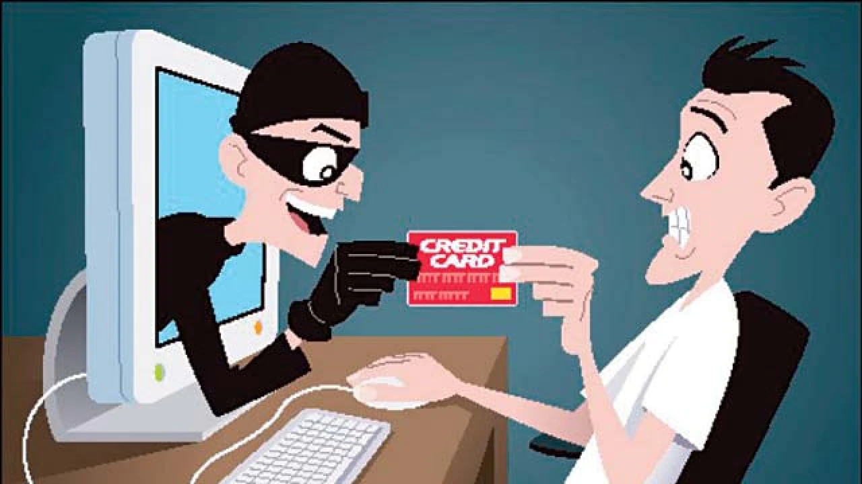
2. Against property
Credit card fraud :
Intellectual property crimes : these include :-
Software privacy
Trademark violations
Theft of computer source code
Copyright infringement
III. Internet time theft : it usage internet hours by unauthorized person which is actually paid by another person.

Slide 6

3. Against organization
Unauthorized Accessing of computer
Denial of service
Virus attack
Trojan horse
Logic bomb
Email bombing
Salami attack
Data diddling

Slide 7

4. Against society
Forgery: currency notes, mark-sheets and stamps etc can be forged by computers and high quality Scanner and Printer.
Cyber Terrorism: use of computer resources to intimidate pr coerce others.
Web Jacking: hackers gain access or control over the websites of another.

Slide 8
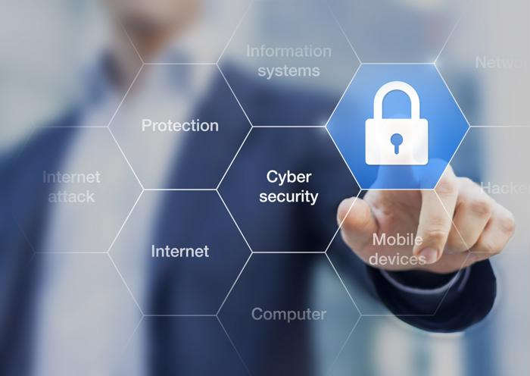
Cyber Security
Cyber Security is the potential activity by which information and other communication systems are protected from against unauthorized use or modifications or even theft.

Slide 9
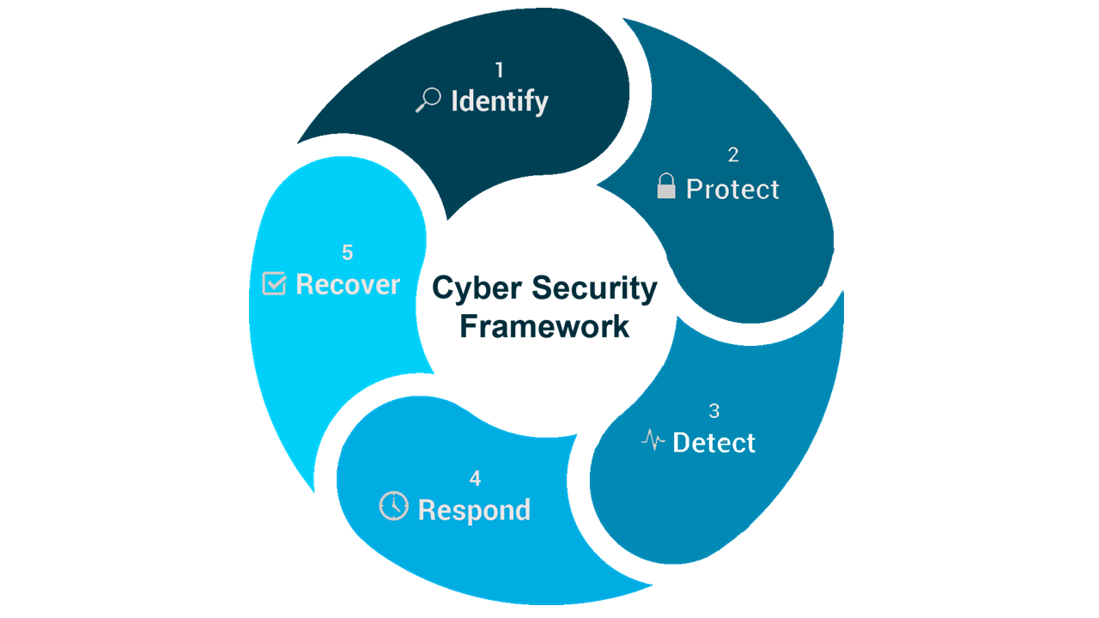
Cyber Security Ctf..

Slide 10

How to Secure Data ?
Keep your operating system and all system software updated regularly.
Do proper password management.
Keep antivirus software updated regularly.
Use firewall and other security software.
Avoid untrusted Wi-Fi connections.
Have data backup, update it regularly.
Avoid surfing untrusted websites.

Slide 11
Thank You

